Slide 1
Smart Office – Find my Colleges
NTT Data Deutschland – Munich, Germany
Ranjitha Kuntimaddi, Tobias Staller, Lukas Friedlmeier

Slide 2
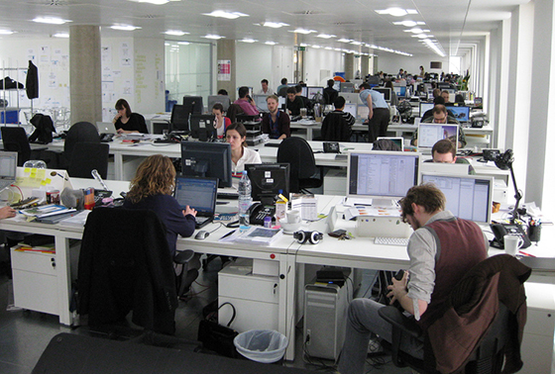

Jack‘s Everday Problem
Meet Jack the Consultant. He is hard working but usually he is a little bit late in the office. Of course all desks are occupied. He always spends a lot of time finding a desk and wastes his precious time. That puts him in a bad mood. He never knows where is team members are located and only interacts with them over chat.

Slide 3
Solution to Jack‘s Problem
A soucre:
where it is easy to know who is sitting where in the office !
to find out if there is a desk available around his team
to know how full the office is ?!
to navigate easily through the building to reach the free desk
SMART OFFICE!!
A cost effective solution where employees can :
find their team location
Find available desks around the team
easily navigate through the office
efficient working environment

Slide 4

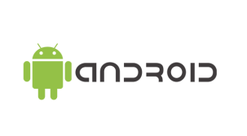
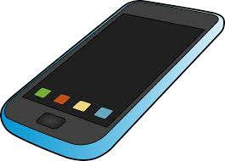
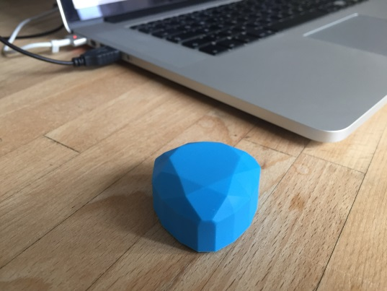


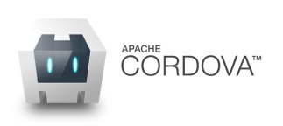


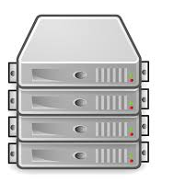
Architecture SmartOffice
Mobile Phone
Desk
Smart Office App
iBeacons Low Energy Bluetooth
Server

Slide 5

Features
SmartOffice
mobile/web application
platform independent
has indoor location tracking
requires no user input
is cost effective solution
time saver
supports social interaction

Slide 6
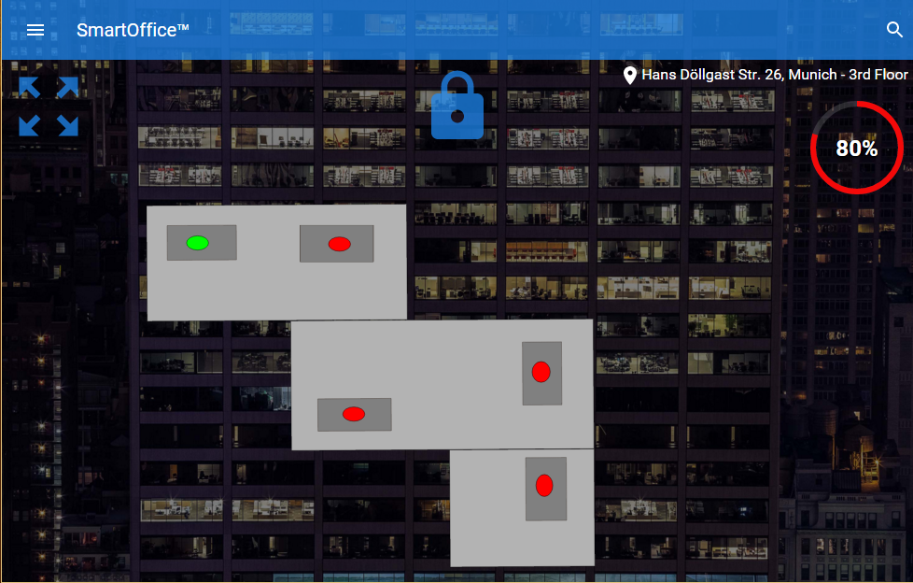
Prototype
Reserved for 70 min
Navigate through office
Office 80% filled
Occupied
Available

Slide 7
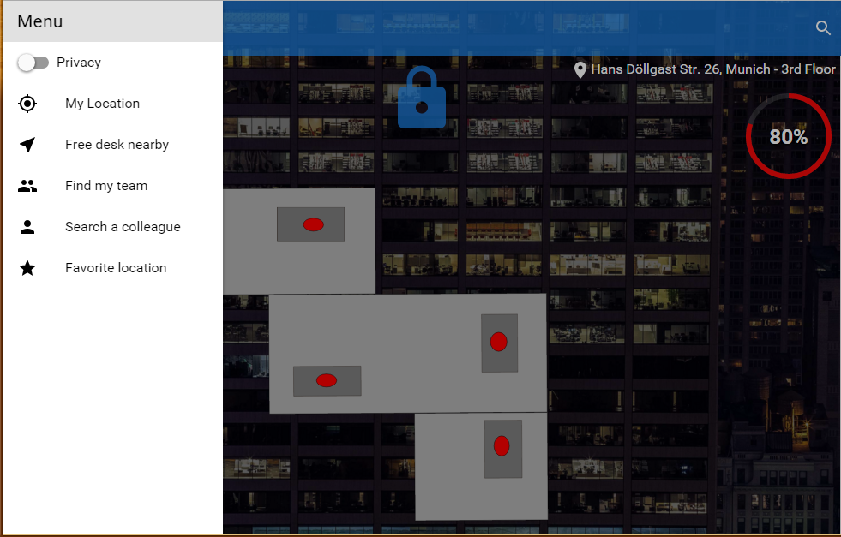
Prototype : Menu

Slide 8


Sucess Story
It is Monday morning. Jack was stuck in a traffic jam and is running late again. Also he spilled his coffee on the way. In the elevator he checks the SmartOffice App for an available desk. He finds a desk in proximity to his team. On the map he can easily find the desk. The app is registering Jack on the map.
Jill, who also uses the SmartOffice App, notices that Jack has entered the office. She hasn't talked to Jack personally in a while. Using SmartOffice she can quickly locate Jack and invites him for a cup of coffee. What a great morning! :)

